Slide 1

DATA SCIENCE LAB - MTH208 Group – 18 WORLD HAPPINESS REPORT (:

Slide 2

Data collection —
Kaggle
worldpopulationreview.com
Web scraping

Slide 3
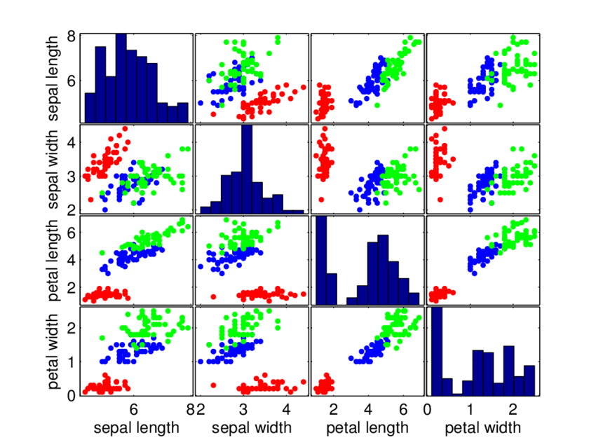
Data set
Data set contains attribute like–
Gdp per capita
Life expectancy
Freedom of life choices
Government corruption
Generosity
Other data set-
Poverty
Continent
Literacy rate
Population density

Slide 4

INSPIRATION and KEY QUESTIONS
– Unique data set
– happiness is a key aspect
– Is happiness report biased in any way ?
– What are the attributes which best quantify happiness ?
– Are there any other factors which can improve the report ?

Slide 5
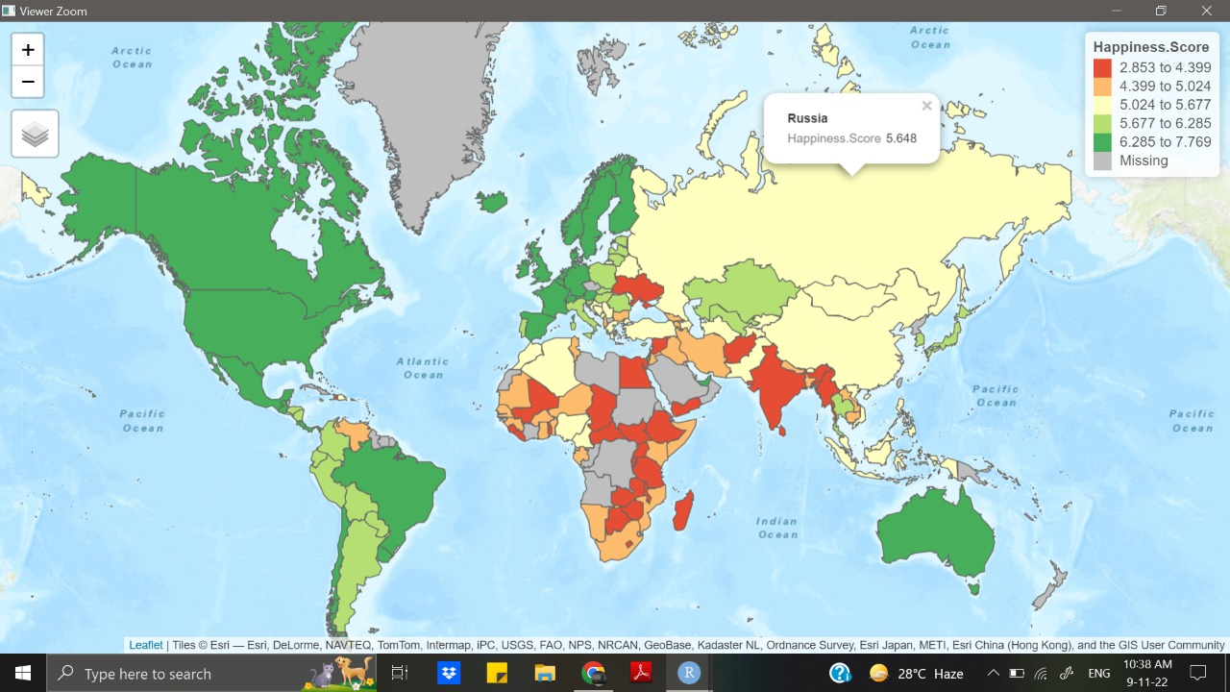
Analysis

Slide 6
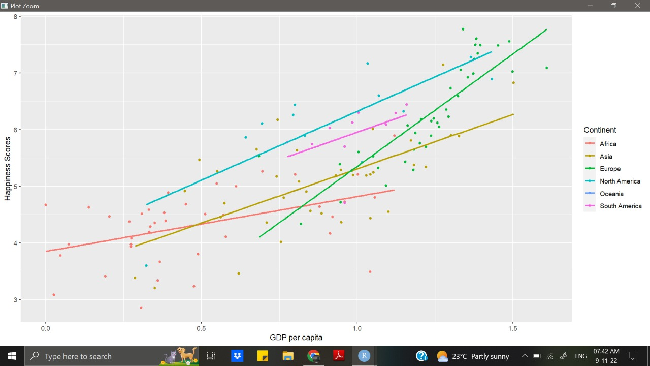
How does GDP affect happiness

Slide 7
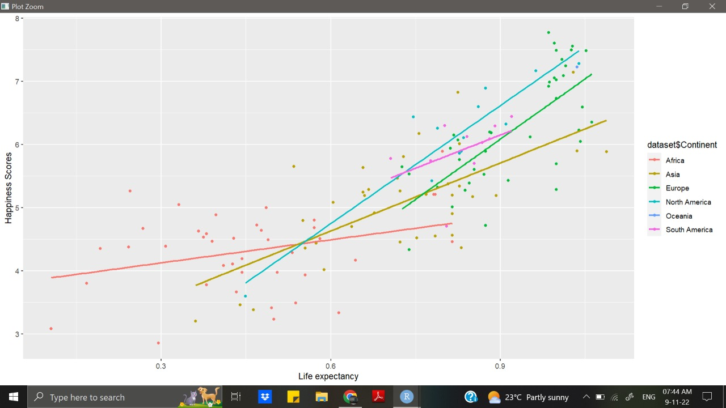
How does Life expectancy affect happiness

Slide 8
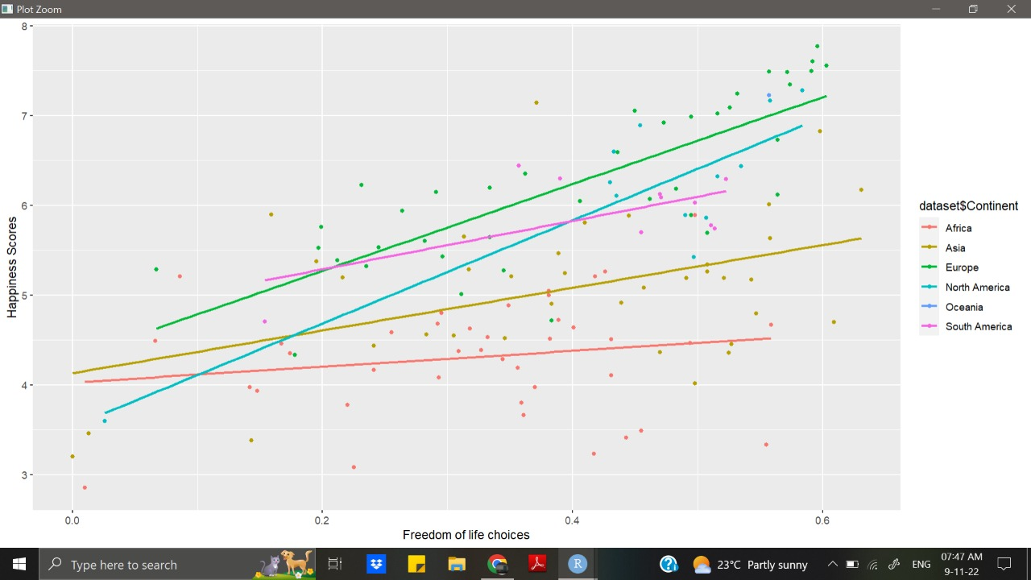
How does Freedom of life choices affect happiness

Slide 9
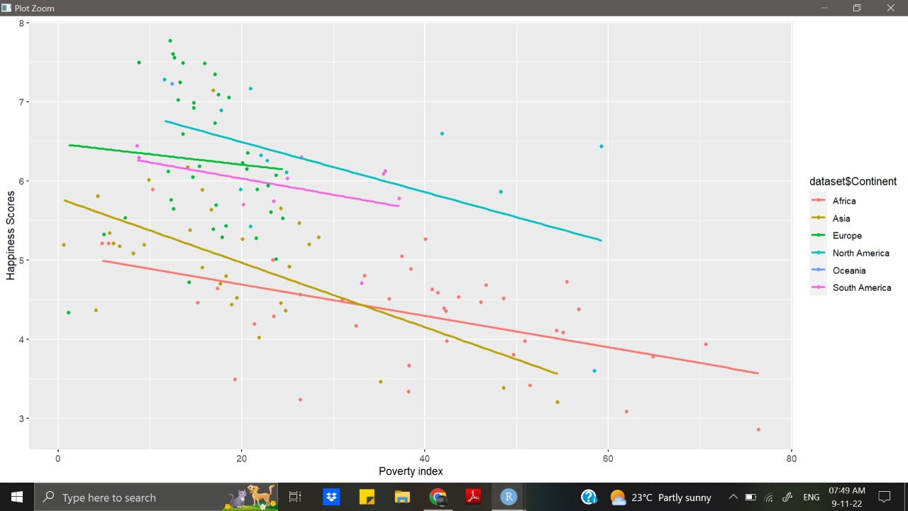
How does Poverty affect happiness

Slide 10
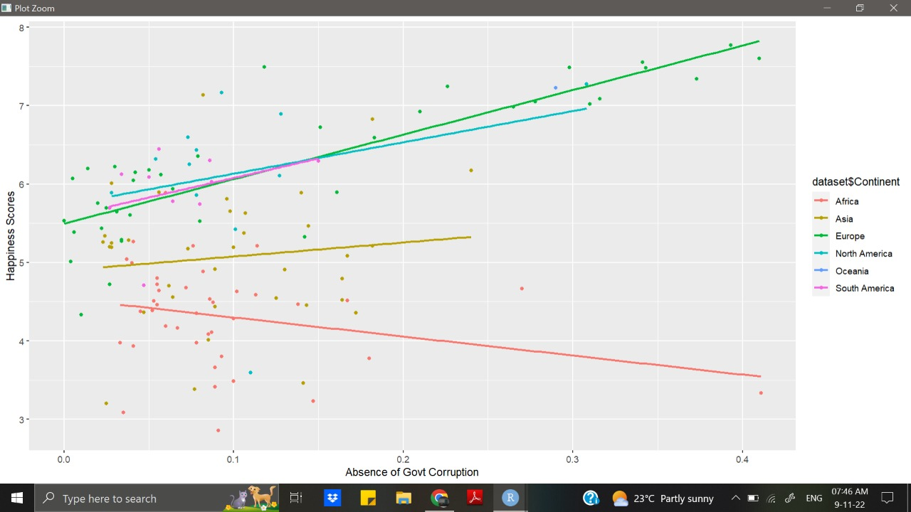
How does Perception of Govt corruption affect happiness

Slide 11
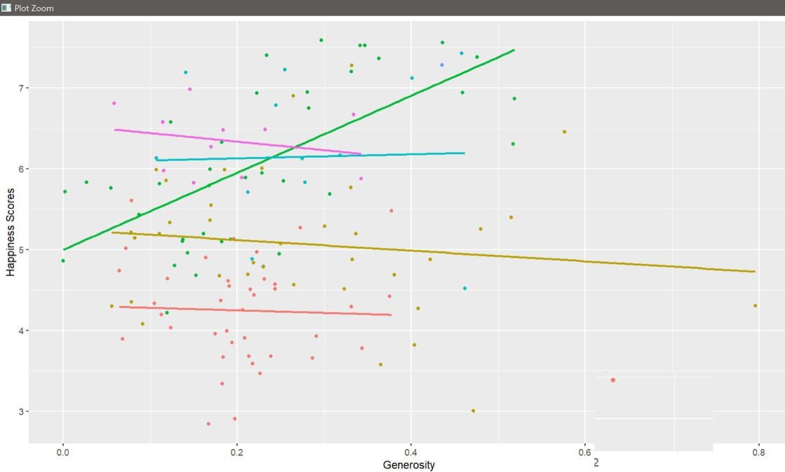
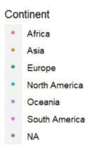
How does generosity affect happiness

Slide 12
How does Perception of Govt corruption affect happiness

Slide 13
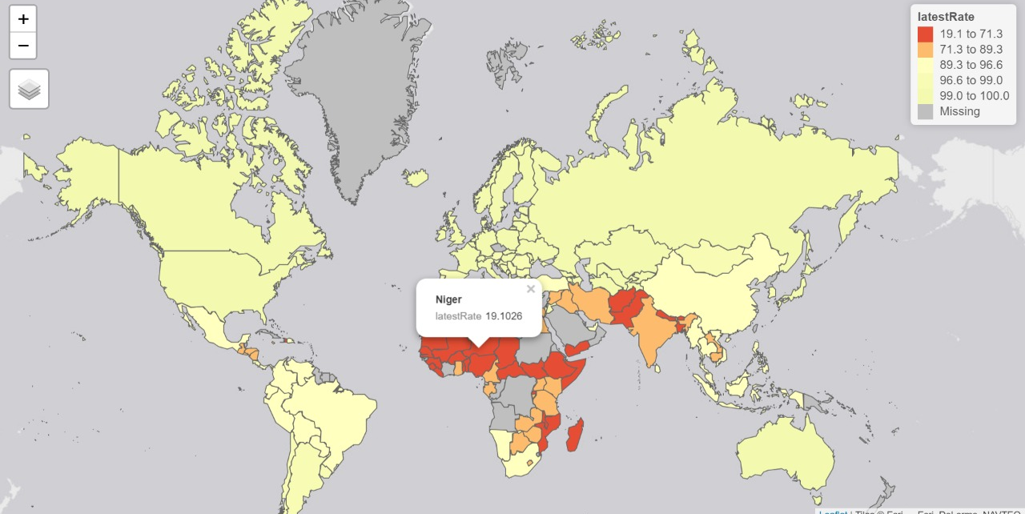
Abnormal behaviour of Africa
LITERACY RATE

Slide 14
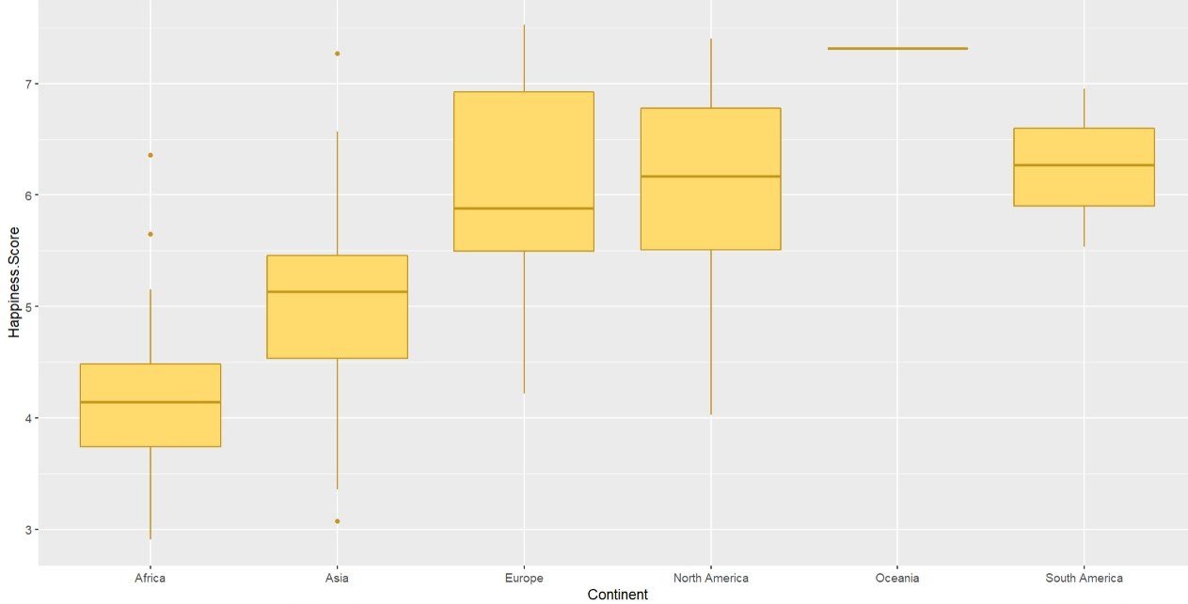

Slide 15
Is happiness report biased toward Europe ?

Slide 16
How does generosity affect happiness

Slide 17
conclusion
Is happiness report biased in any way ?
– Life expectancy and GDP per capita are computed from ready-made data of the World Bank and World Health Organisation (WHO) respectively.
– Sample size: For the other metrics they survey typically 1,000 people in a country annually. The surveyors state they are unable to reach out to many countries for the annual survey. In countries where they have been able to conduct annual surveys on a recurrent basis, the sample size spikes to 3,000
– Data is missing for many African countries but for very few european and north american countries.

Slide 18
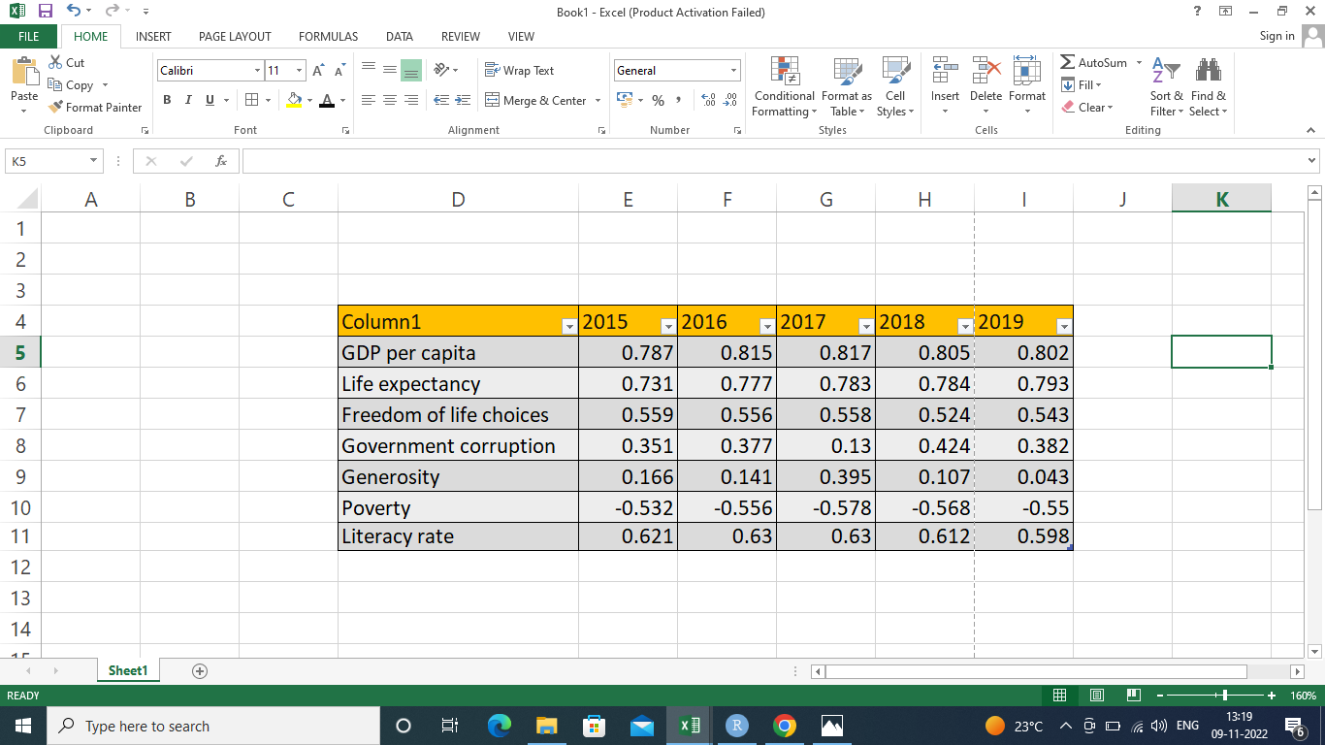

Slide 19
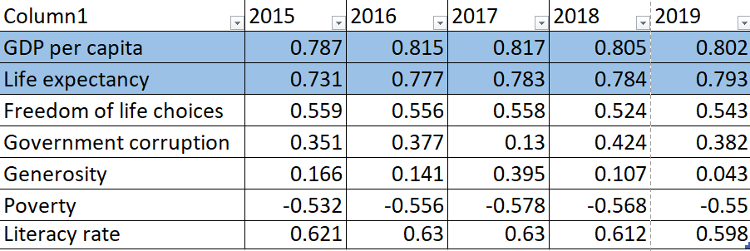
CONCLUSION
What are the attributes which best quantify happiness ?

Slide 20
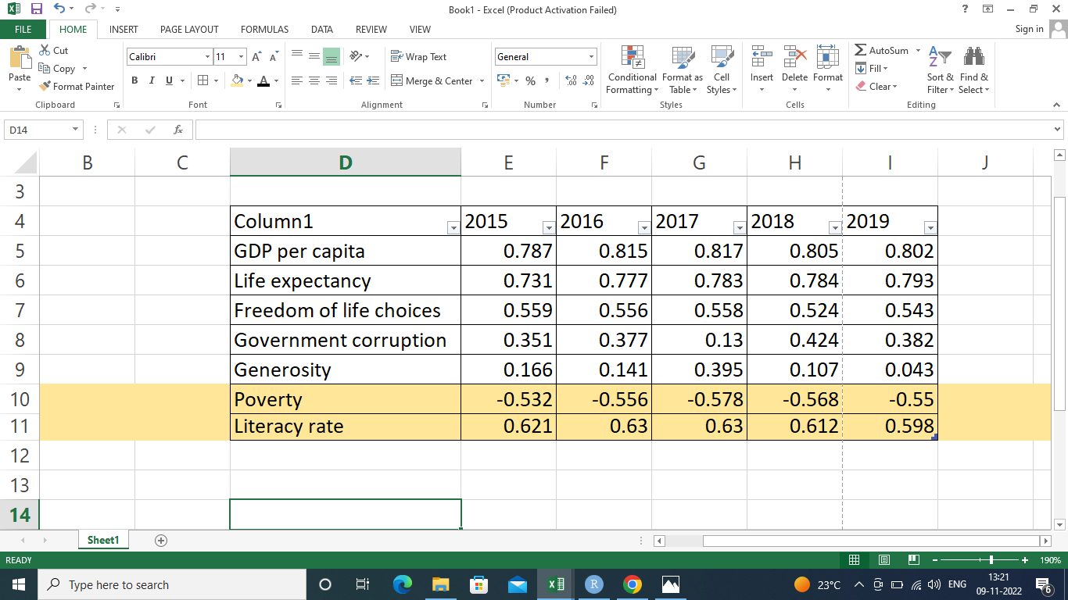
CONCLUSION
– Are there any other factors which can improve the report ?

Slide 21
shiny

Slide 22
References
https://www.kaggle.com/
https://worldpopulationreview.com/
https://www.thehindu.com/news/international/explained-what-is-the-world-happiness-report/article65240772.ece?homepage=true
https://in.pinterest.com/
The earth institute

Slide 23
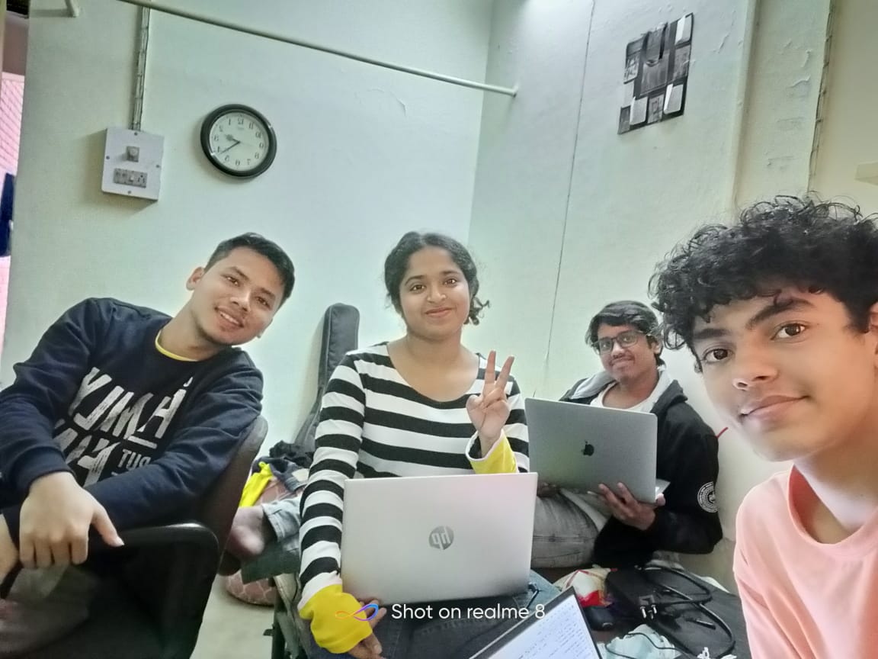
Course Instructor – Dootika Vats
Team members –
Pratyusha Bala
Tanmay Purohit
Kundan Kumar
Shem Basumatari

Slide 24


